Slide 1

Course code : CSE4001 Course title : Cloud Computing Module : 6 Topic : 1
Fundamental Cloud Security & Mechanisms

Slide 2
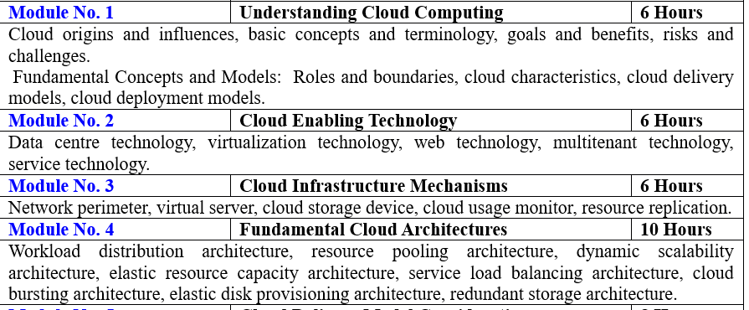

Slide 3
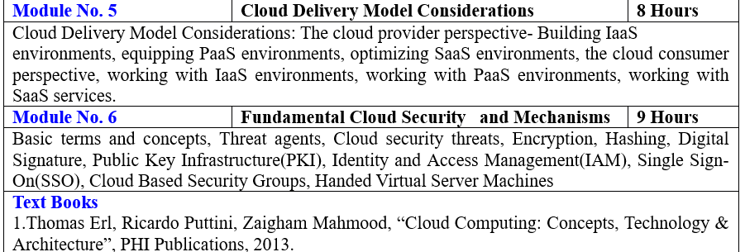

Slide 4
Objectives
This session will give the knowledge about

Slide 5
Reference

Slide 6
Thank You!

